Slide 1
Transitions & Animation
From CSS3 and how to Trigger with JavaScript

Slide 2
Transitions & Animations-What are they?
Transition
“Allow the values of CSS properties to change over time, essentially providing simple animations.”(Textbook name)
Animation
“CSS3 animations allows animation of most HTML elements without using JavaScript or Flash!” (W3 Schools)
Transitions in CSS are applied to an element and specify that when a property changes it should do so over gradually over a period of time. Animations are different. When applied, they just run and do their thing. They offer more fine-grained control as you can control different stops of the animations. (css-tricks)

Slide 3
Animation Code
/* Safari 4.0 - 8.0 */
@-webkit-keyframes example {
0% {background-color:purple;}
25% {background-color:blue;}
50% {background-color:purple;}
75% {background-color:yellow;}
100% {background-color:purple;}
}
/* Standard syntax */
@keyframes example {
0% {background-color:purple;}
25% {background-color:blue;}
50% {background-color:purple;}
75% {background-color:yellow;}
100% {background-color:purple;}
}
div {
width: 590px;
height: 590px;
background-color: purple;
position: relative;
-webkit-animation-name: example; /* Safari 4.0 - 8.0 */
-webkit-animation-duration: 2s; /* Safari 4.0 - 8.0 */
-webkit-animation-iteration-count: infinite; /* Safari 4.0 - 8.0 */
animation-name: example;
animation-duration: 2s;
animation-iteration-count: infinite;
text-align:center;
text-color: white;
}
div h2 {
text-align:center;
color: white;
position:center;
}

Slide 4
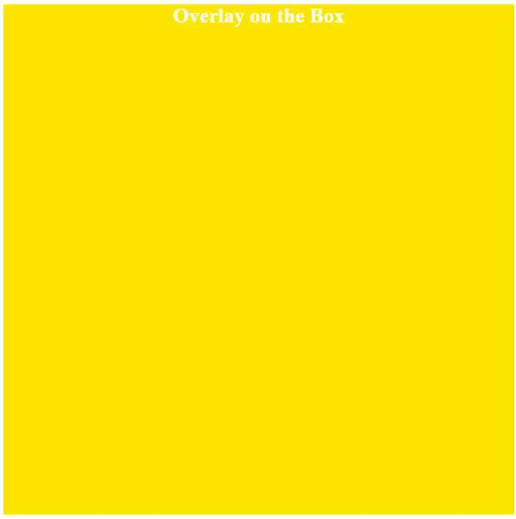
Animation Example

Slide 5
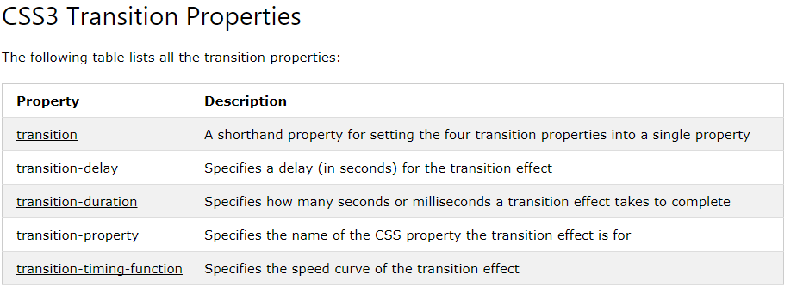
Transitions

Slide 6
How to Trigger with JavaScript!
https://css-tricks.com/controlling-css-animations-transitions-javascript/

